Slide 1

UofL Research and Innovation: Website Redesign
Project Manager: Emily Wantland
Web Developers: Sohal Patel, Matthew Jackson
Database Admins: Scott Pettyjohn, Keegan Foulke
Systems Analyst: Nathan Moran
Team GOD
(Granter of Data)
Notes:
Emily

Slide 2
Problem
Solution
Poor UX/UI
Redesign website
Too many clicks to reach content
100+ dead links
Stakeholder oriented design
All dead links eliminated
3 clicks MAX to reach content
Notes:
Emily

Slide 3
Stakeholders
Researcher
View content
Industry
View content
RSVP for events
Student
View content
Create/edit/delete user profile
Create/edit/delete user profile
Event Reminders
Apply for grants
Create/edit/delete user profile
Event Reminders
Event Reminders
Notes:
Nathan

Slide 4
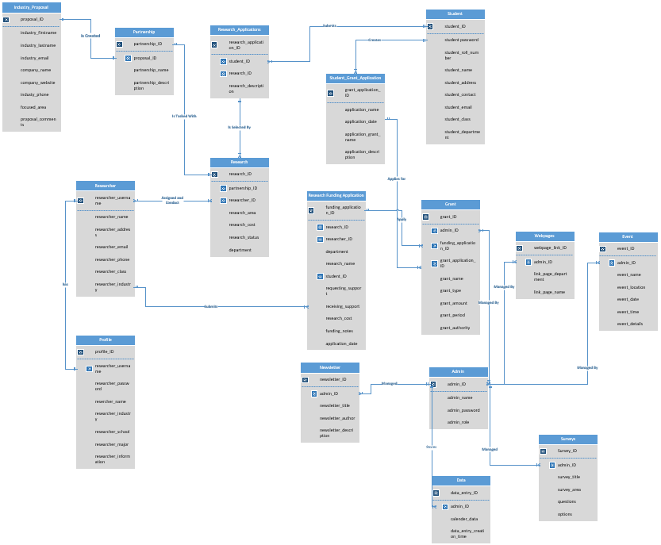
Full Schema
Notes:
Scott

Slide 5
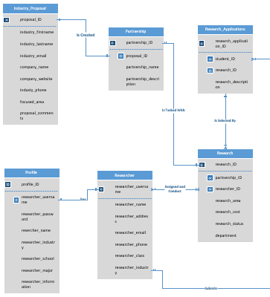
Sub-Schema: Research
Notes:
Scott

Slide 6
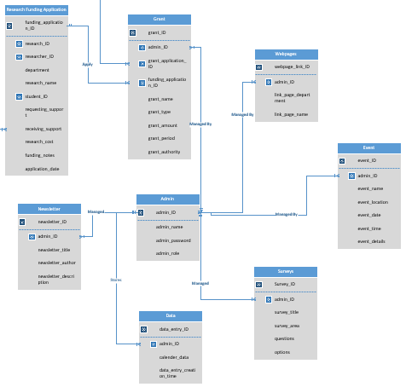
Sub-Schema: Admin
Notes:
Scott

Slide 7
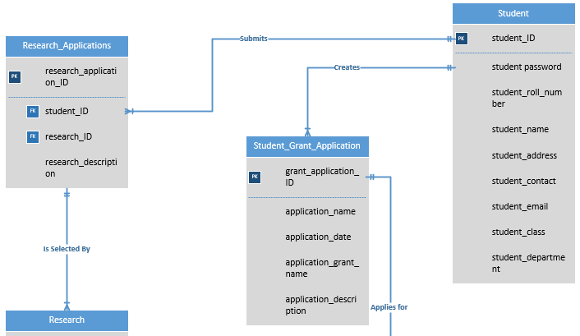
Sub-Schema: Student
Notes:
Scott

Slide 8
Technologies and Tools
Project Management Software:
Asana
Wireframe Development:
Pencil
Development Platform:
Microsoft Visual Studio
Database Platform:
SQL Sever
Entity Relationship Diagram
Visio
Notes:
Matt

Slide 9
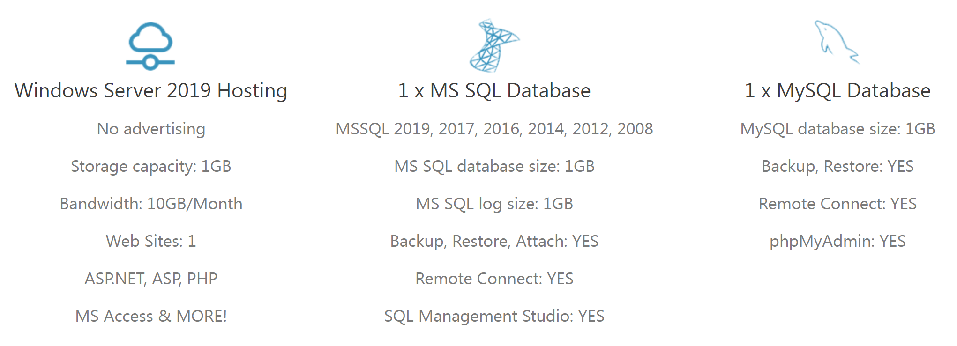
Hosting and Domain
SmarterASP.NET
.
Domain
www.ResearchAtUofL.com
Notes:
Sohal

Slide 10
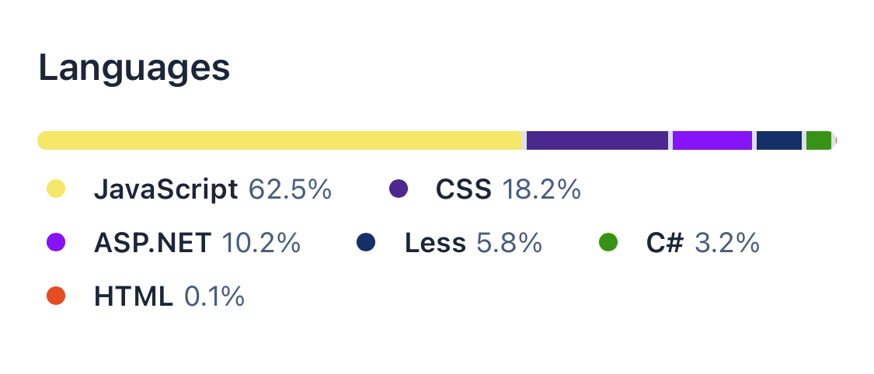
Languages Used
JavaScript – 62.5%
CSS – 18.2%
ASP.NET – 10.2%
Less – 5.8%
C# – 3.2%
HTML – 0.1%
Notes:
Sohal

Slide 11
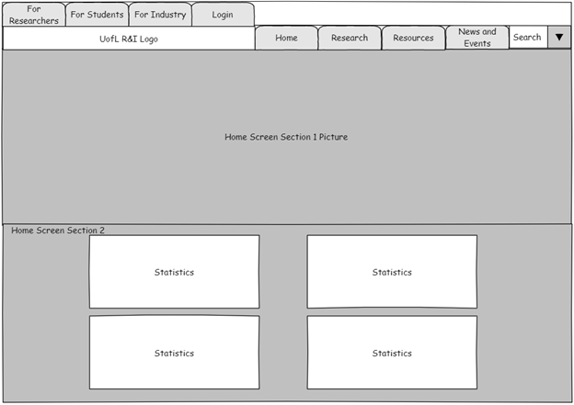
Wireframe
The landing page features 6 sections
Section 1 – Banner picture
Section 2 – Statistics and infographics
Notes:
Scott

Slide 12
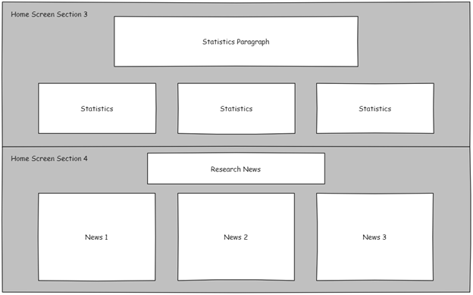
Wireframe
Section 3 – Statistics and infographics
Section 4 – Research specific news section
Notes:
Scott

Slide 13
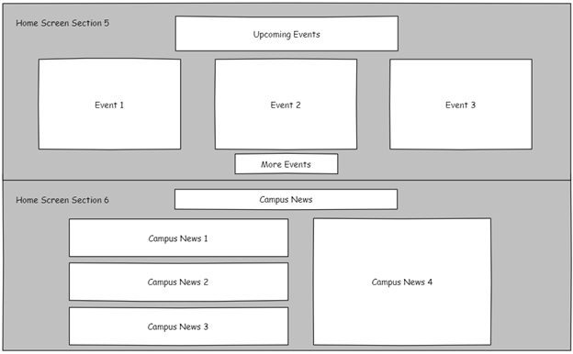
Wireframe
Section 5 – Condensed events section
Section 6 – Campus specific news section
Notes:
Scott

Slide 14
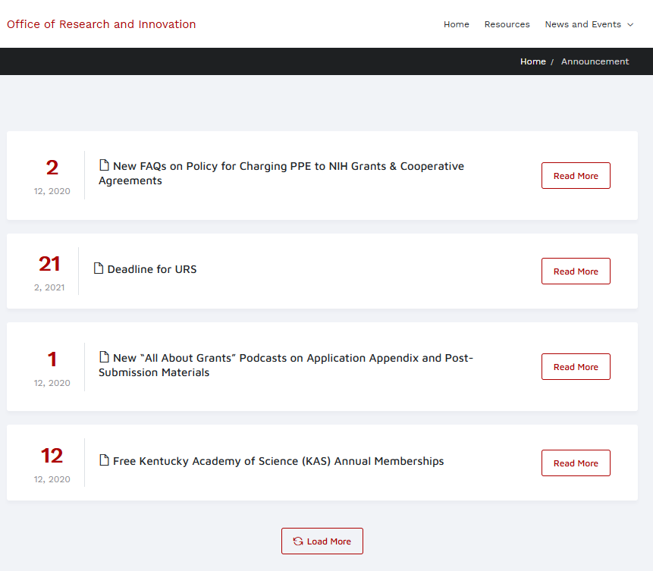
Announcements Page
Brings announcements to the view in a pleasing way
Modular design updated by date
Able to load more for looking into the future
Ordered by date
Notes:
Keegan

Slide 15
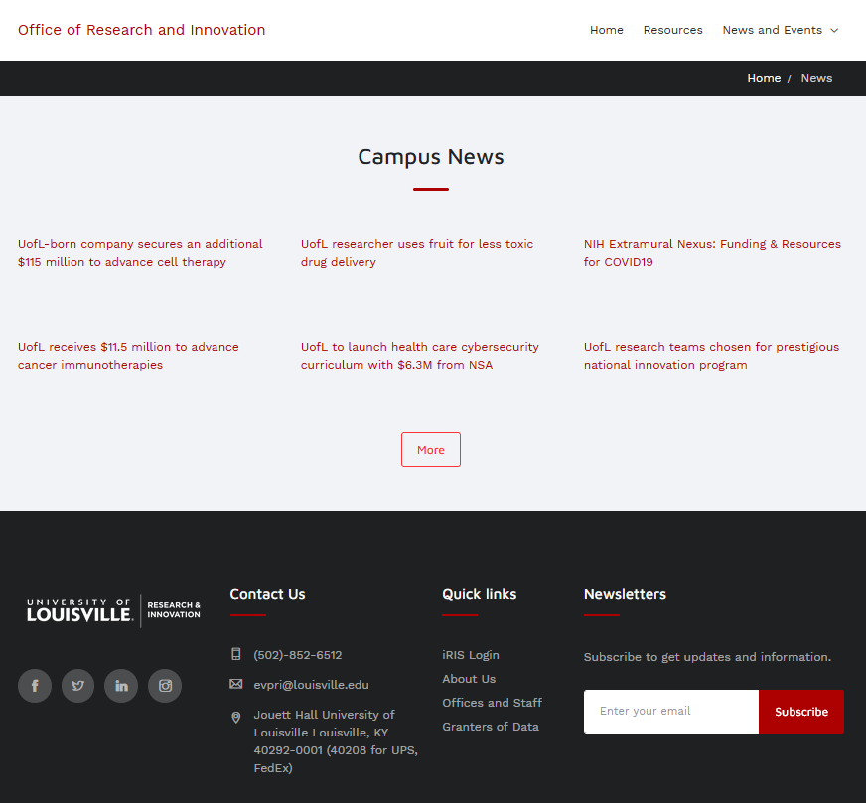
News Page
Like announcements page
Ordered by date
Grid style offers customization
Clickable to expand info
Notes:
Keegan

Slide 16
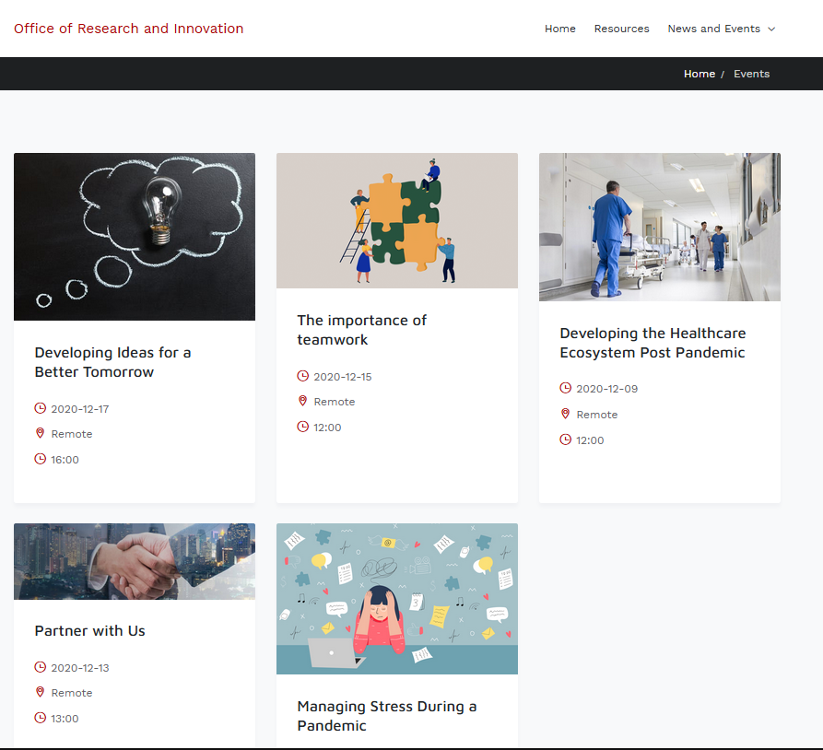
Events Page
Like previous two pages
Gives time and location
View Details gives more info
Grid style offers responsive design for multiple devices
Notes:
Keegan

Slide 17

Summary
Domain:
www.ResearchAtUofL.com
Hosted by:
SmarterASP.NET
Team GOD (Granter of Data)
Lead Developer:
sohal.patel@louisville.edu
Notes:
Matt

Slide 18

Questions?
Notes:
Sohal

